Slide 1
Buffer Management in SQLite
오기환
(wurikiji@gmail.com)
SKKU VLDB Lab. (27334)

Slide 2
Contents
Pcache in Pager
Pcache management in SQLite
SQLite internals

Slide 3
PCACHe in pager
Page cache of SQLite

Slide 4
Page Cache (Pcache) in SQLite
Whenever SQLite accesses a database
Part of Pager
Implemented in “pager.c”, “pcache.c”, “pcache1.c”
Prefixes
sqlite3Pager, sqlite3_bcache

Slide 5
Applications using SQLite3 Library
SQLite
Page Cache
Filesystems
OS Buffer Cache
In Memory
Device
Drivers
Secondary Storage
(HDDs, SSDs)
On-disk Database file

Slide 6
Page Cache in SQLite
1. App requires a database page
Through VDBE and Btree
2. Search an empty entry from pcache
If a page already in pcache then return it
3. Initialize pcache and page object
4. Read a database page from disk
Pager’s role

Slide 7
Page Request Overview
Main
APIs
Btree
Pager
Page Cache
Disk
Apps
Send Queries
Request
A Page
Fetch
A Page
Search
A page
Return
Record
Return
page
Yes
If A page
exists
No
Read
A page
Transmit
A page
Return
Record
Return
page

Slide 8
Pcache management in sqlite
Page cache of SQLite

Slide 9
Page Cache Basic
Every entry in a cache holds a single page
“Btree” module only operates on cache
through the pager
Clean means
Cached page is exactly matches what is on disk
Dirty means
Cached page is modified and need to be persisted on disk

Slide 10
Buffer Replacement Algorithm
SQLite Pcache uses “LRU” algorithm
Least Recently Used pages become victim
Remove a page from LRU list when it is pinned
Add the page to LRU list when it is unpinned
When LRU is empty and can not create more page
Flush dirty pages

Slide 11
Buffer Replacement Algorithm
Most
Recent
Least
Recent
Clean
LRU
Add
Eviction
Most
Recent
Least
Recent
Dirty
LRU
Add
Eviction

Slide 12
SQLite internals
Implementations on SQLite

Slide 13
Source files
All of the codes related to buffer management is implemented in 3 main files and related headers
pager.c, pcache.c, pcache1.c
pager.c implements Pager module
APIs for Btree module
pcache.c implements upper layer of page cache
APIs for Pager module
pcache1.c implements low layer of page cache
APIs for page cache managements

Slide 14
Get Requested Page
1. Search from a Page Cache’s hash table
2. Find recyclable page
3. Allocate new page
4. Flush dirty page

Slide 15
Main
APIs
Btree
Pager
Page Cache
Disk
Apps
Send Queries
Request
A Page
Fetch
A Page
Search
A page
Return
Record
Return
page
Yes
If A page
exists
Not in Cache
Recycle
page
Yes
Get
Free Page
Allocate
Page
Yes
Get
New Page
Flush
Dirty Page
Receive
Data
Read
A Page
Transmit
Data

Slide 16
Buffer Structure
Ready to Write
SQLite’s Page Cache
Case 1
Page Cache
LRU List
Referenced
Page
Page Cache
Drity LRU List
Pinned
Flushed
SQLite’s Page Cache
Case 2
Page Cache
LRU List
Referenced
Page
Page Cache
Drity LRU List
Unpinned

Slide 17
Low Level Entry for Clean LRU
sqlite3PagerGet()
Get requested page from pcache or disk
sqlite3PcacheFetch()
Wrapper function for pcache1Fetch()

Slide 18
Low Level Entry for Dirty LRU
sqlite3PagerGet()
Get requested page from pcache or disk
sqlite3PcacheFetchStress()
Setup victim dirty lists
Call flush function: pagerStress() for default

Slide 19
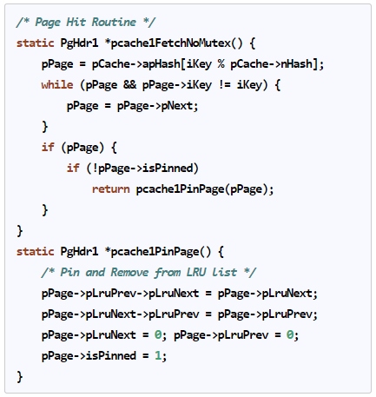
Page Hit Scenario
Get page from pcache

Slide 20
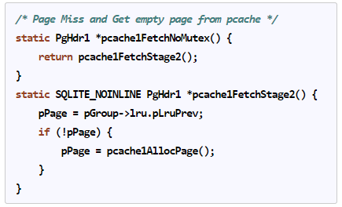
Page Miss Scenario 1
Get page from LRU or allocate new page

Slide 21
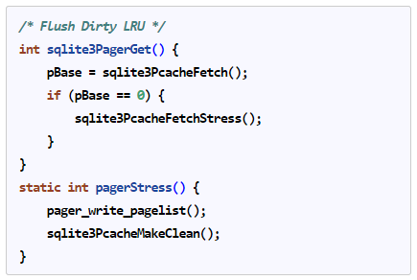
Page Miss Scenario 2
Flush dirty pages

Slide 22
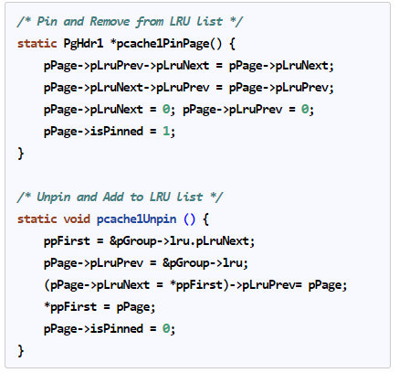
Clean LRU Management

Slide 23
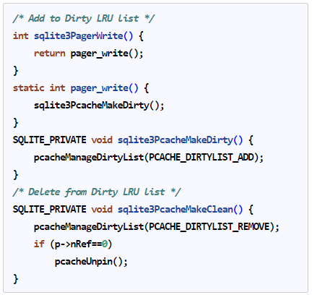
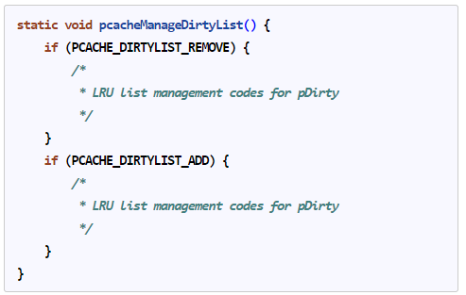
Dirty LRU Management

Slide 24
Hit/Miss Ratio
Cache Hit: Requested page is in cache
Cache Miss: Requested page is not in cache
Hit ratio of page cache is important

Slide 25
90% Hit ratio vs. 95% hit ratio
For 1,000,000 (1 million) page requests
In a hit ratio aspect
Difference: Only 5% point
95/90 = 1.05x improvements
In a miss ratio aspect: 10% vs. 5%
Disk access time >>>> Memory access time
2x improvement
100,000 reads vs. 50,000 reads

Slide 26
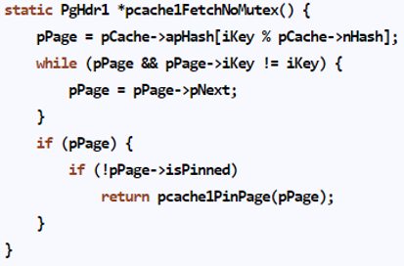
Hit/Miss Ratio in SQLite
All get requests process via sqlite3PagerGet()
Page from pcache is interpreted in cache hit

